Slide 1
C2
Offensive Security

Slide 2
Command and Control
The way our shells call back
Red vs. Blue
Cat and mouse
Leveling up our C2
Outbound traffic isn’t always allowed on firewalls

Slide 3
Beaconing
Implant calls out at set intervals
Could have some variance
Likely can be set to continuous
If a machine calls out to website every 60 seconds for 24 hours is that suspicious?
Jitter
Offset the timing of the beacons

Slide 4
TCP & HTTP
We’ve used a lot of these while using Metasploit
Cleartext protocols
Anyone that wants to see what is being sent can see into these
Network taps
No need for break and inspect
Using Security Onion (Think Kali, but for Network Security Monitoring)
Covered in DefSec 438

Slide 5
SMB
How does Windows work normally?
SMB!
NOT over the Internet
Internal to a network
This is really good for host to host or server to host

Slide 6
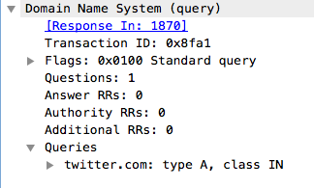
DNS
How do systems connect to the Internet?
We can prepend data to a request
Good if nobody is watching
BAD if they are

Slide 7
HTTPS
Best communication method
Common
All networks have this
Business requirement
Added layer of encryption
HTTPS Break and Inspect

Slide 8
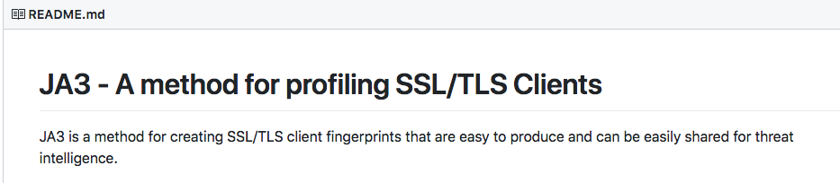
Profiling our tools
New defensive tools
Things like this are coming

Slide 9
HTTPS (Using other sites)
Sites that allow for posting data
Bitbucket, pastebin, etc
Privacy is an issue here
Traffic to GitHub may look normal
No indication to look any deeper

Slide 10
Domains
Name
Reputation
What has happened with them?
Are they new?
Have they had any reports of malware?
https://www.brightcloud.com/tools/url-ip-lookup.php
https://urlfiltering.paloaltonetworks.com/

Slide 11
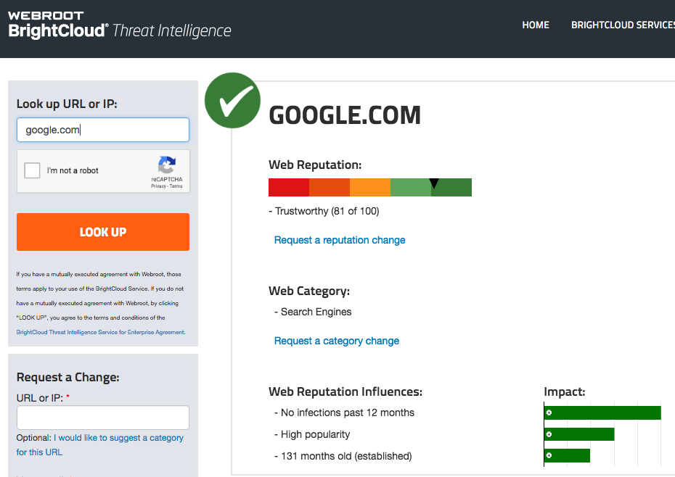
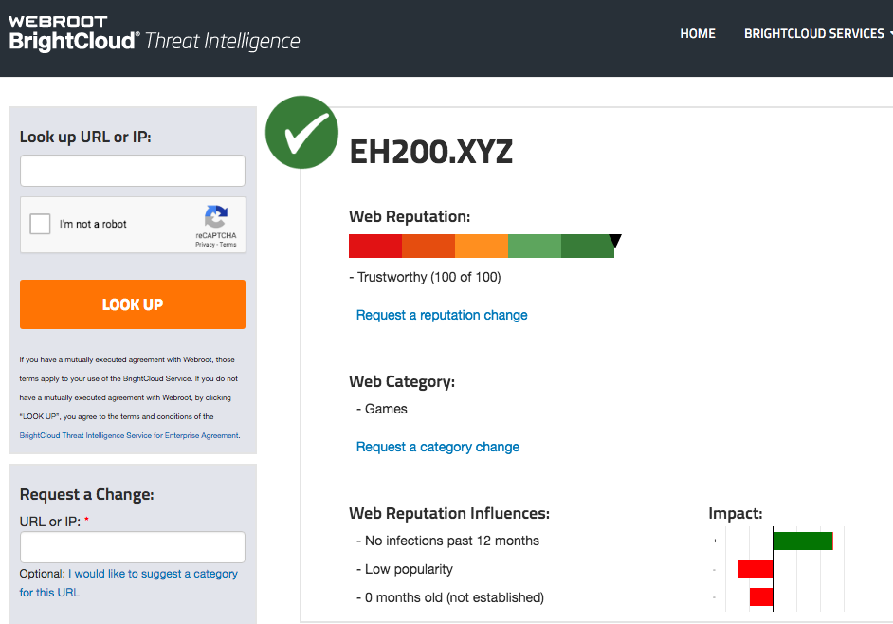
Checking a domain

Slide 12
So what can we do?
Build a legitimate looking site, let it run for awhile
Age establishes credibility
No infection
Time allows for categorization
Buy an expired domain with categorization and reputation
https://auctions.godaddy.com/

Slide 13
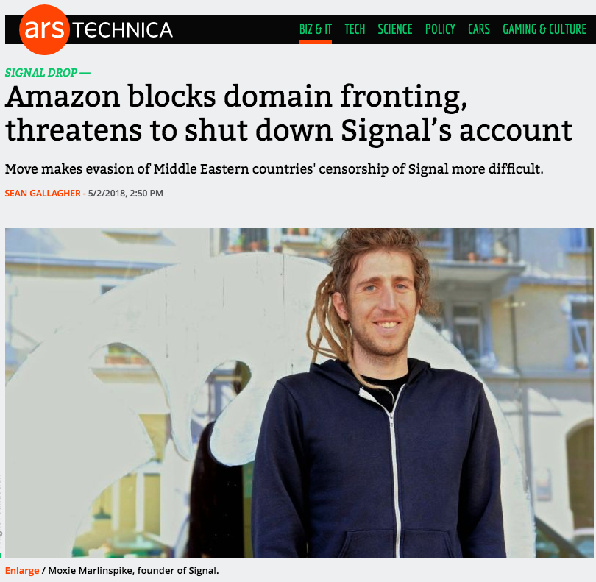
Domain Fronting
Hides the true endpoint of a connection
Used to avoid censorship
Signal, Telegram in Egypt, UAE, Qatar
Abused by attackers
Uses domain names at different levels of communication

Slide 14
Domain Fronting Cont’d
HTTPS Request to good domain name
Host Header in HTTP request points somewhere else
HTTPS Request to legit site
Inside of that HTTPS tunnel, you redirect through the endpoint to the real site you want to go to
Very difficult to detect

Slide 15
Others?
Ping?
What if the firewall blocks inbound/outbound ping?
Other protocols?

Slide 16
Infrastructure Security
We’re exposing our own infrastructure to the Internet
We need to keep our stuff secure
Limit callbacks as well for scope reasons
Firewalls
Patching
Good security practices in general
https://github.com/bluscreenofjeff/Red-Team-Infrastructure-Wiki

Slide 17
Redirectors
Don’t want to have traffic calling back directly to your external IP
Could get categorized as malicious
Blacklisted
Best practice to keep client data in your network
Instead of leaving servers running on cloud instances
So what do you do?
Redirectors!

Slide 18
Redirectors cont’d.
Creating a reverse tunnel
If an SSH tunnel goes down, SSH tunnel doesn’t come back up
From internal system:
autossh -M 0 -o "ServerAliveInterval 30" -o "ServerAliveCountMax 3" -R 443:LOCALIP:10000 -i ./r1.key root@X.X.X.X

Slide 19
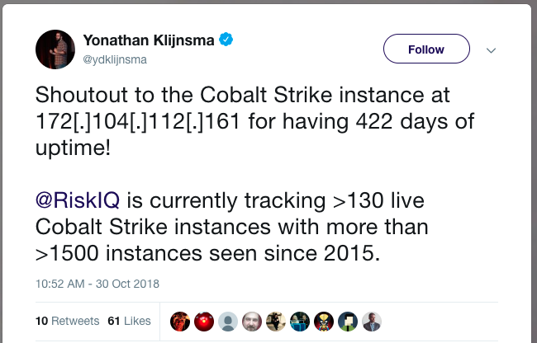
Don’t use default configs
https://twitter.com/ydklijnsma/status/1057299300558954496?s=12

Slide 20
Moving Target
Many of the things we just talked about will get caught on networks with a moderate level of security
Some still work
In a year, who knows

Slide 21
References
https://github.com/bluscreenofjeff/Red-Team-Infrastructure-Wiki

